Slide 1

Institute of Aeronautical Engineering
(Autonomous)
Department of Computer Science and Engineering
Automatic Resume Generator
NAME : R.SANJAY KUMAR (19951A05P8)
K L SURYA KIRAN (19951A05L6)
SUMANTH (19951A05L4)
SRI SAILAM(19951A05K9)

Slide 2
Abstract
Automatic Resume Generator is a cloud based application from which we can generate resume automatically by accessing information from social networking sites like Facebook, Gmail, and LinkedIn etc. wherever the user leaves footprints using API’s provided by the respective social networks. All information generated by the application will be accurate about the end user because it accesses the information that is provided by user himself in social networking sites.
Here we are learning how to develop new services by integrating and publishing third party services. Compared to existing systems user don’t needs to enter all information manually, some fields will be automatically filled by the application where user can cover all the information and reduce the time in preparing his resume, User cannot completely rely on the application as it contains the only information he has provided before. This application is best suitable for the person who often uses social networking sites.

Slide 3
Introduction
Resume is a written document representing background information of a person including qualification, work experience, credentials, and accomplishments that is required to apply for a job. The first step in processing of an interview is to short list the applicants based on their resumes. Resume is a part of application process for most of the jobs. Since resume is the first thing reviewed by the managers of company that you will be applied for, you need to create the most impressive and accurate resume which needs some time as well as some efforts.
Requirements:
HTML
CSS
JAVASCRIPT

Slide 4
Literature survey:
Cloud computing: Cloud computing is computing that is internet based that provides resources, data and also devices on demand. Cloud computing is all about providing three types of services , SAAS, PAAS, IAAS.
Social network: Social network is a network of social interactions where people communicate directly or indirectly, directly in the sense chatting, voice call, video call etc and indirect communicating includes, comments, posting information, images and etc.
Application Programming Interface: An Application Programming Interface is a set of method and subroutines that are used to define the communication between many software components.
How API Works: API enables the communication between software application and remote application over the Internet through a series of calls.

Slide 5
Existing System
There exist plenty of online resume generators with various resume templates, the drawback associated with these software are , for an accurate and perfect resume we use online platform where each field of resume should be filled up by with personal details in code and execute it manually and also it needs more time and effort in order to create a good and accurate information.

Slide 6
PROPOSED METHOD:
There exist a SDK for Gmail and Facebook applications that allows you to connect to their application and then allow you to access their respective API (Stores the personal data) to obtain the protected resources from user profile. Here, SDK is a set of tools that is required to develop a software which enables you to create an application for any platform. Proposed system comprises of a component called authentication that supports the following cases,
1) New user : the application should redirect the user to registration page
2) New page: Give your personal information

Slide 7
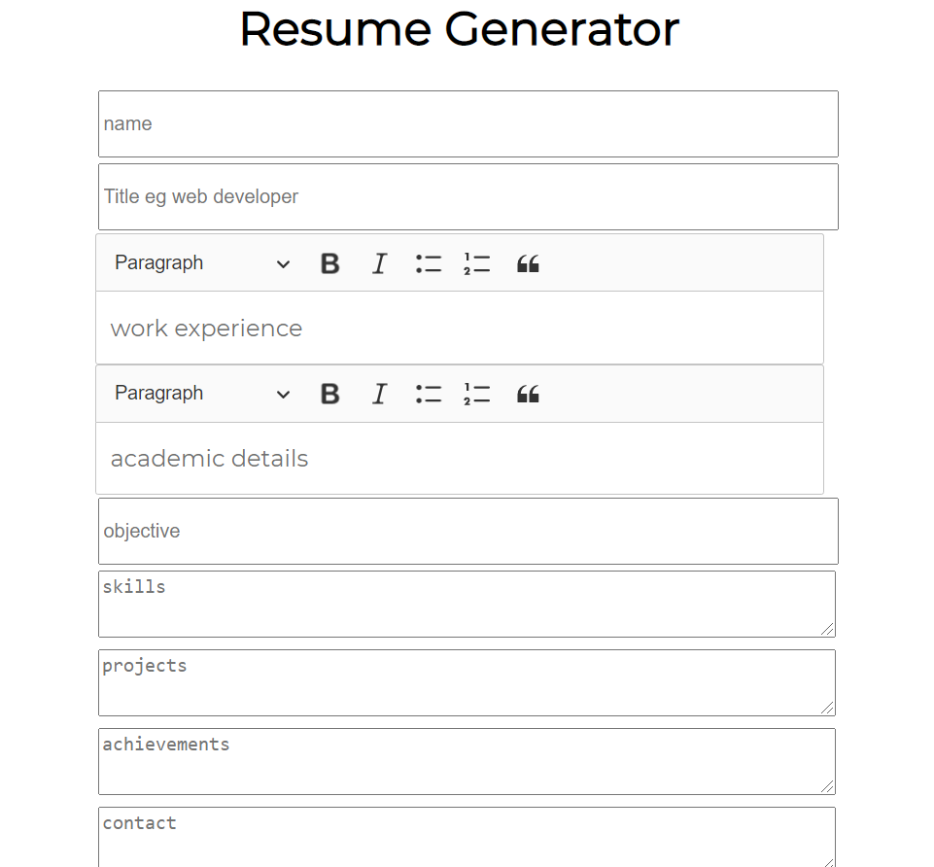
OUTPUT AND DISCUSSIONS:
When we run the code , we move to a new web page where we have to fill the details in the given form and submit the form then we will get the resume .

Slide 8
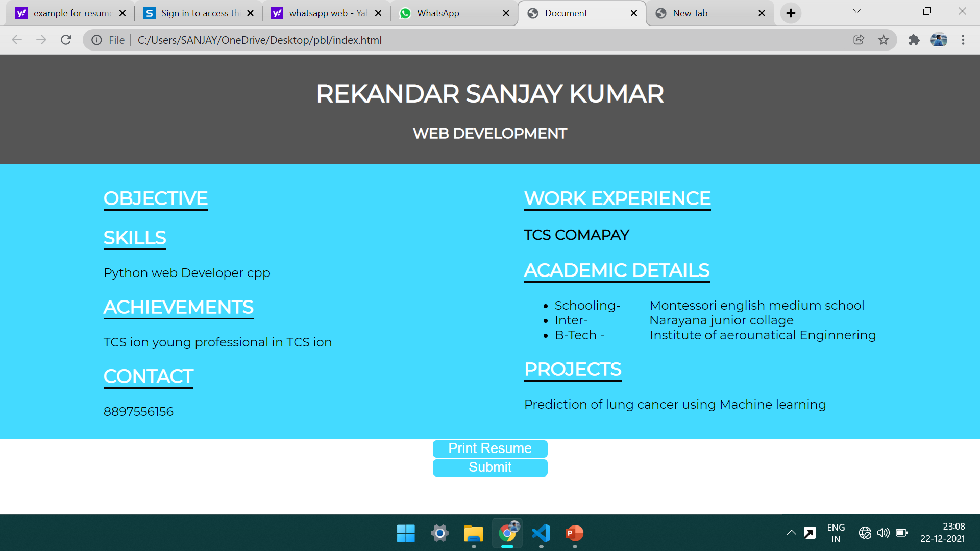
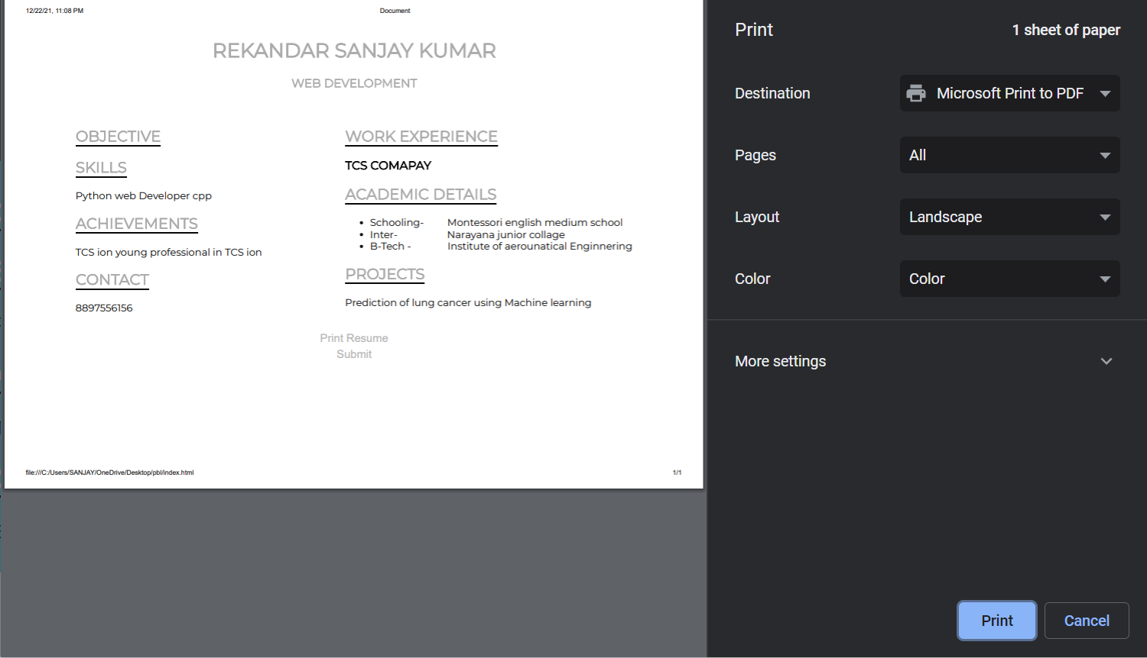
OUTPUT:

Slide 9
Conclusion
Since there is no need for developers to develop the application from scratch instead uses the APIs which requires less effort and fewer resources comparatively, can be developed independently without the need of team of resources which was impossible to do alone before without team resource. For example developers have combined Facebook and Gmail applications to develop new and useful applications. By making information available the idea of how to apply it is what becomes important. One more use of our application is, person who don’t know how to create resume, they can use our application by entering their details and generates a resume. Presently we are accessing foot prints of user from only two social networking sites like Facebook and Gmail. In future it can be extended to many.

Slide 10
THANK YOU

